Slide 1
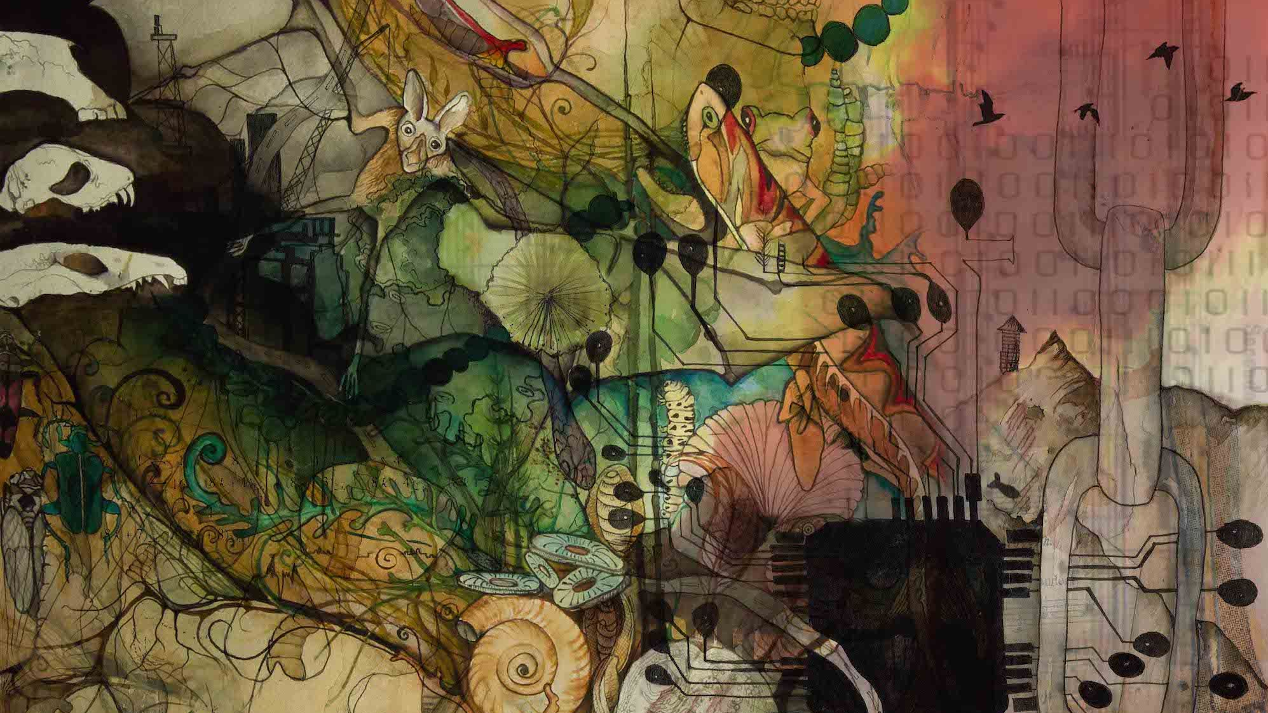
Co-Designing Young People’s Pathways to Net-Zero Futures
Peter Kelly
School of Education and Centre for Research for Educational Impact (REDI) Deakin University,
https://youngpeoplesfutureslab.org
youngpeople_sustainablefutures

Slide 2
Professor Peter Kraftl, The University of Birmingham (UK) Associate Professor Arinola Adefila, Buckinghamshire New University (UK) Associate Professor Luke Howie, Deakin University (AUS) Dr Seth Brown, RMIT University (AUS) Dr James Goring, Deakin University (AUS)
Sub-heading

Slide 3
1. Net Zero Futures (NZFs): What? Why? 2. Micro-credentials/digital badging. What? Why? 3. Gamified Learning. What? Why?
4. Project outline. Year 1: Co-Design. Year 2: Build. Year 3: Test. 5. Possible First Projects. Pakistan, Ghana. Sao Paulo. Fund for Innovation in Development (FID) 6. Next Steps. Including other project possibilities.
Sub-heading

Slide 4
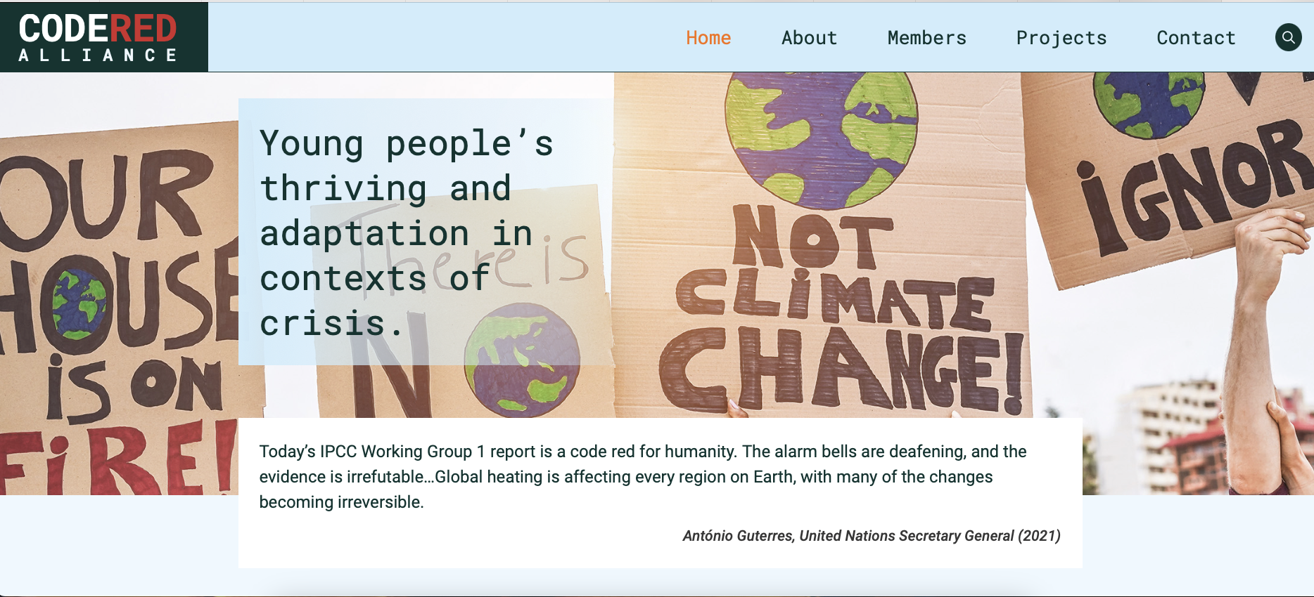
The Problem
Notes:
But we know this code red plays out differently in different contexts, with different consequences for different groups and populations – human and non-human

Slide 5
Net Zero Futures (NZFs) – the ‘official story’?
Carbon Neutrality by 2050: Achieving net-zero greenhouse gas emissions globally by mid-century.
Sustainable Development: Ensuring economic and social growth that preserves environmental health for future generations.
Renewable Energy Transition: Replacing fossil fuels with renewable energy sources like solar, wind, and hydro.
Technological Innovation: Utilizing advanced technologies for energy efficiency and effective carbon capture.
Global Cooperation: Promoting international collaboration to meet climate targets, as outlined in the Paris Agreement.

Slide 6
Net Zero Futures (NZFs) – the ‘reality’?
Climate Change: Does not STOP climate change, but limits temperature rise.
Greenwashing: Misleading claims erode trust and progress.
'Climate Wars': Politicised actions create conflict and delays.
Global Disparities: Unequal challenges and opportunities worldwide.
Tech Hurdles: Need major investment in renewables and carbon capture.
Behavioural Change and Adaptation: Requires lifestyle changes and global adaptation.

Slide 7
Net Zero Futures (NZFs) – Developing Young People’s ‘Futures Literacies’ (How do they ‘read’ and ‘write’ their futures?).
Project Goal: Build young people’s understanding of of the challenges and opportunities of NZFs through a 3-year action research project.
Co-Design: Collaboratively create a digitally badged, gamified micro-credential program – create ‘value’ (social, cultural, economic).
Target Group: Engage young people (16-24) alongside educational institutions, communities, businesses, unions, and governments.
Learning Experience: Use gamified, world-building activities to create ‘value’ for young people for sustainable, regenerative, and just futures.
Outcomes (Value Creation): Foster aspirations, resilience, and capabilities among young people for the challenges and opportunities of NZFs.

Slide 8
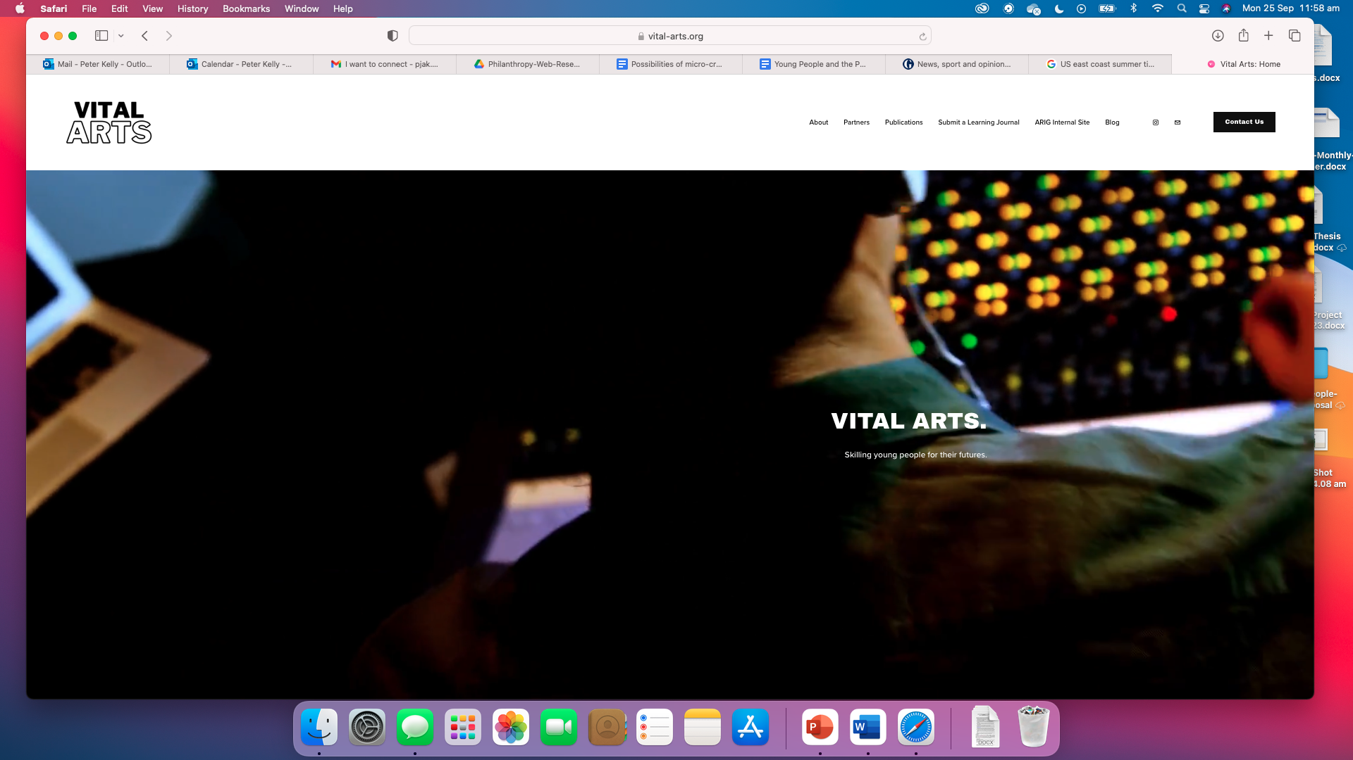
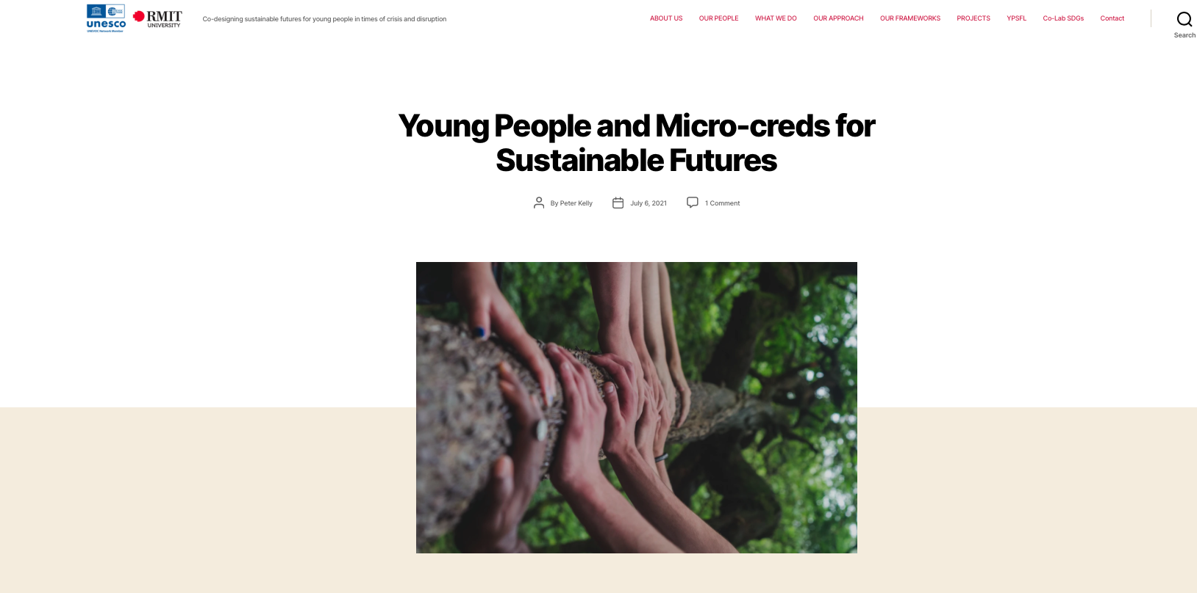
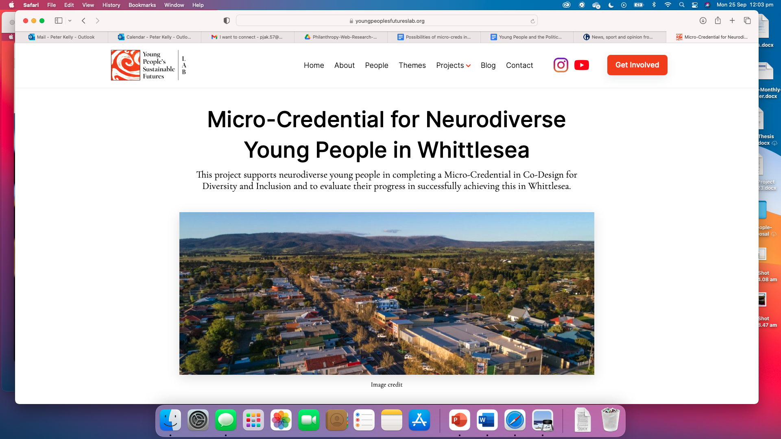
Micro-credentials/digital badging – creating and capturing ‘value’ for young people and their communities

Slide 9
Micro-credentials/digital badging
Micro-cred: ‘certification of assessed skills and knowledge that learners have demonstrated or acquired through a short course of study or training’.
Digital badge: ‘an online record of achievements, tracking the recipient’s communities of interaction that issued the badge and the work completed to get it’.

Slide 10
Micro-credentials: How they work
Learning
Assessment
Digital badge
Governance
A short course or a formalised, structured program that already exists or is built to create social, cultural, economic value.
Value created needs to be assessed by someone, somewhere, somehow
A means for signalling the skills, capabilities, forms of value created in a short course/micro-cred.
Ongoing conduct and assessment needs to be governed in a way that maintains trust and integrity in the value created and signalled.

Slide 11
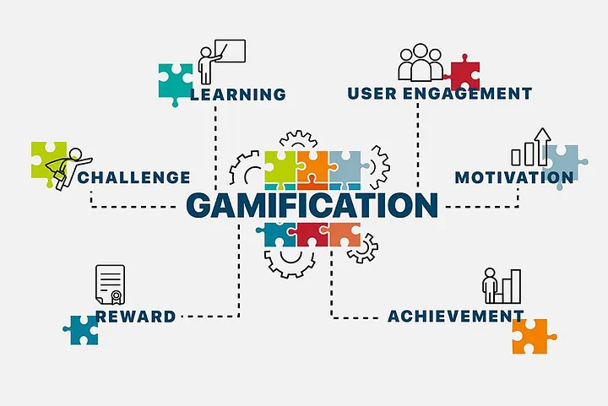
Gamified Learning
Key Learning Benefits and Outcomes of Gamified Learning Short Courses
Enhanced Engagement and Retention: Interactive quests and rewards boost motivation and help learners retain information better.
Skill Development: Promotes critical thinking, problem-solving, and strategic planning through real-world scenarios.
Personalised and Immediate Feedback: Adaptive challenges cater to individual learning styles, with instant feedback for quick improvement.
Collaboration and Social Learning: Encourages cooperation and communication through multiplayer and team-based tasks.
Real-World Application and Ethical Awareness: Allows practical application of knowledge and raises awareness about Net Zero Futures.

Slide 12
Gamified Micro-cred for NZFs
Level 4 | Global collaborations and partnerships to complete quests/tasks Build in evaluation and well-being measures Award an ‘open badge’ when complete – signaling completion of the micro-cred and the creation of ‘value’ – to be digitally used by young people for different purposes
Level 3 | Thematic choices that start to have a more global perspective Completing quests/tasks Build in evaluation and well-being measures Award an in-game badge when complete – need to complete before progressing to next level
Level 2 | Entry from a particular ‘place’ – following from L1, but choose a particular theme from a number of choices Completing quests/tasks Build in evaluation and well-being measures Award an in-game badge when complete – need to complete before progressing to next level
Level 1 | Starting level Entry from a particular ‘place’ – using the social and cultural context to shape content/activities Focused on foundational knowledges/completing quests/tasks Build in evaluation and well-being measures Award an in-game badge when complete – need to complete before progressing to next level

Slide 13
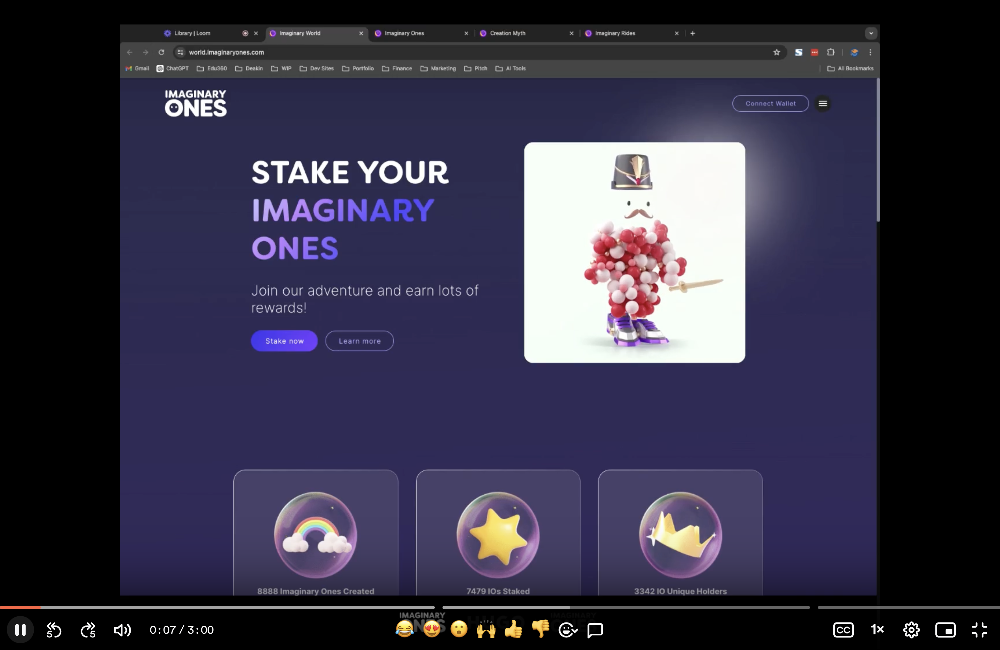
Gamified Micro-cred for NZFs

Slide 14
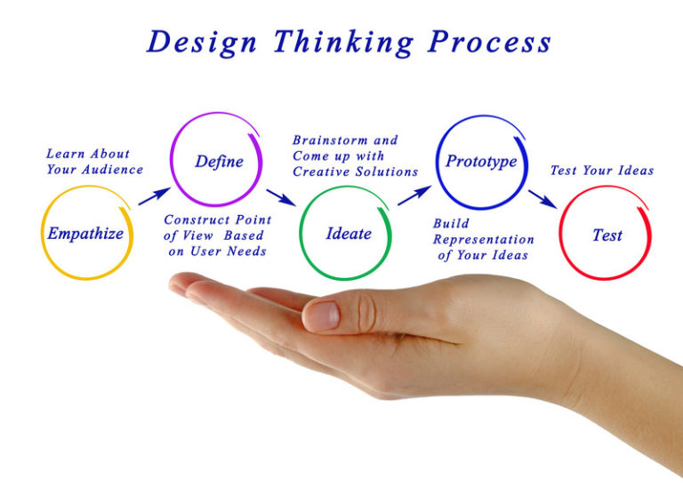
Project outline. Year 1: Co-Design. Year 2: Build. Year 3: Test
Stakeholder engagement, culturally appropriate co-design processes with young people – action research cycles, that can include the award of a micro-cred in co-design for youth leaders in co-design process.
Learning design process – including testing and evaluation of micro-creds with stakeholders.
Digital learning platform (web and App) development process.
Digital badging architecture process – embed in short course or enterprise agreement with badging platform.
Establishment of start-up Not-For-Profit (NFP) process.
Ongoing process evaluation informed by theory of change based in assumptions about gamified learning and theories of learning

Slide 15
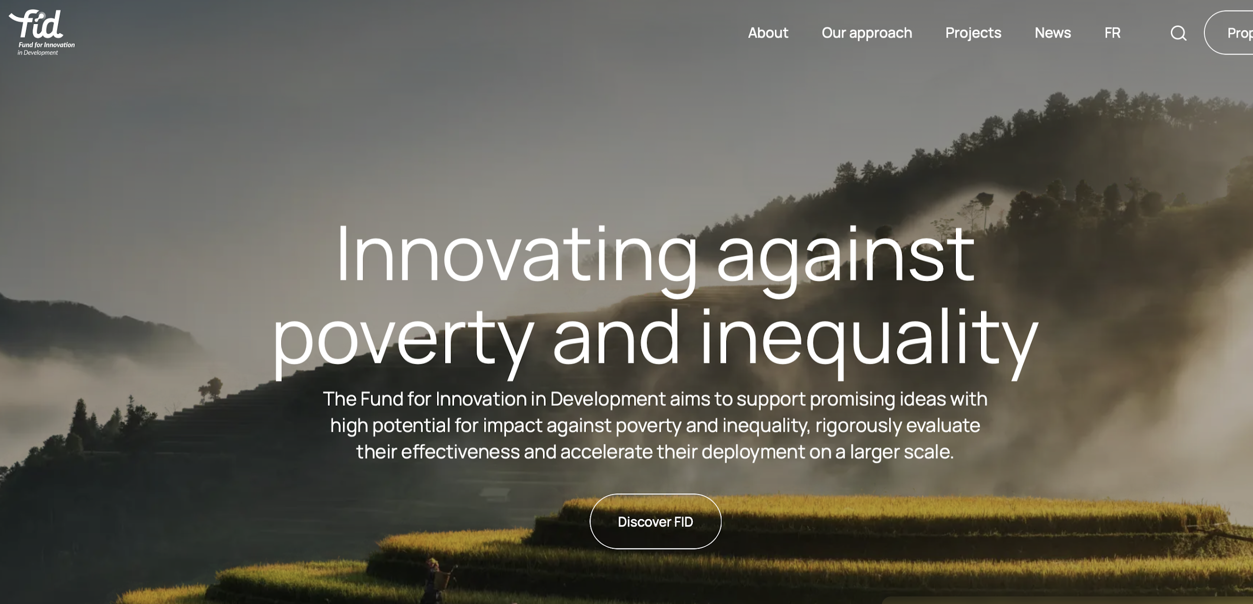
Possible First Projects: Pakistan, Ghana, Brazil. Fund for Innovation in Development (FID)

Slide 16
Next Steps
Starting points…
The Fund for Innovation in Development application
Next 2 months - in country teams feedback from presentation – how would co-design, starting points, trajectories look and feel like in different places?
Identify co-funders, business, philanthropy on application
Submit FID application by end of 2024
Other funding possibilities and opportunities (a non-competitive process?)
Circulate proposal in networks
Identify other possible partners/collaborations/funders
Follow-up conversations about other possibilities – that are not reliant on a competitive process
…and beyond

Slide 17
The Present 2017 [Digital collage of watercolour imagery] Author: Aviva Reed http://www.avivareed.com/
See: https://youngpeopleanthropocene.org

